Slide 1
Software Design and Analysis CS-3004 Lecture#10
Dr. Javaria Imtiaz,
Mr. Basharat Hussain,
Mr. Majid Hussain

Slide 2
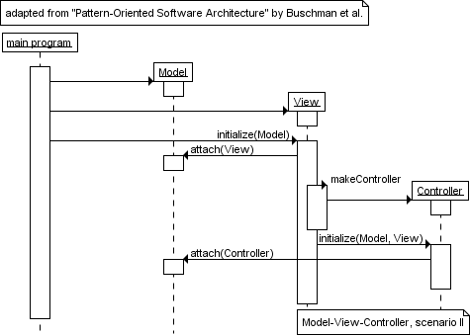
Quiz # 4
Write code for the given sequence diagram.
:Runner
createMVC
create
:
create
:
create
:

Slide 3
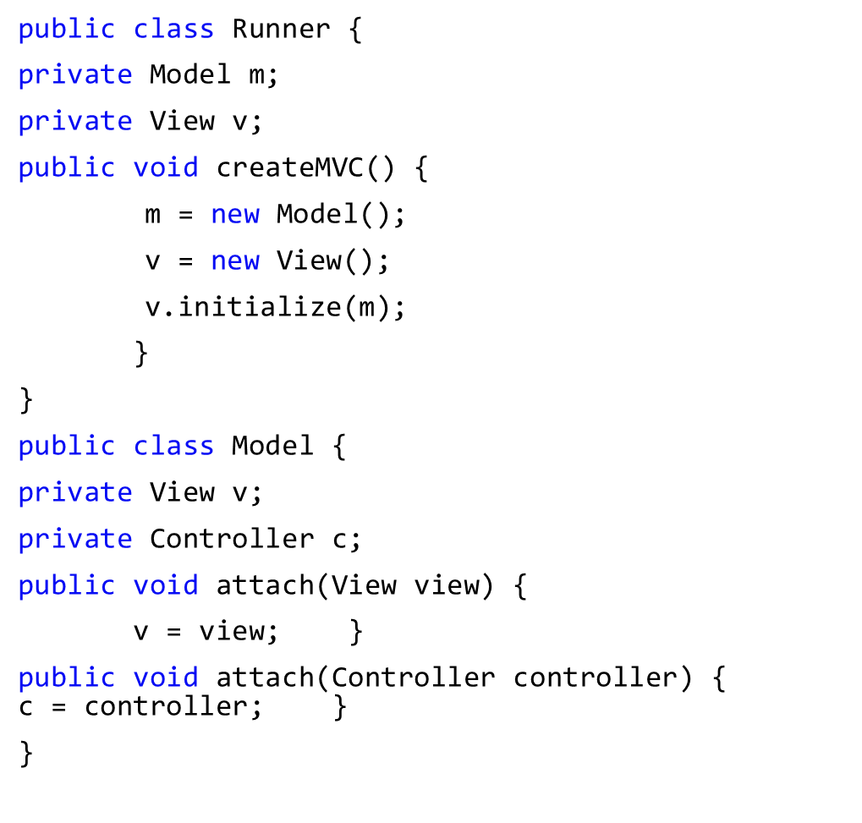
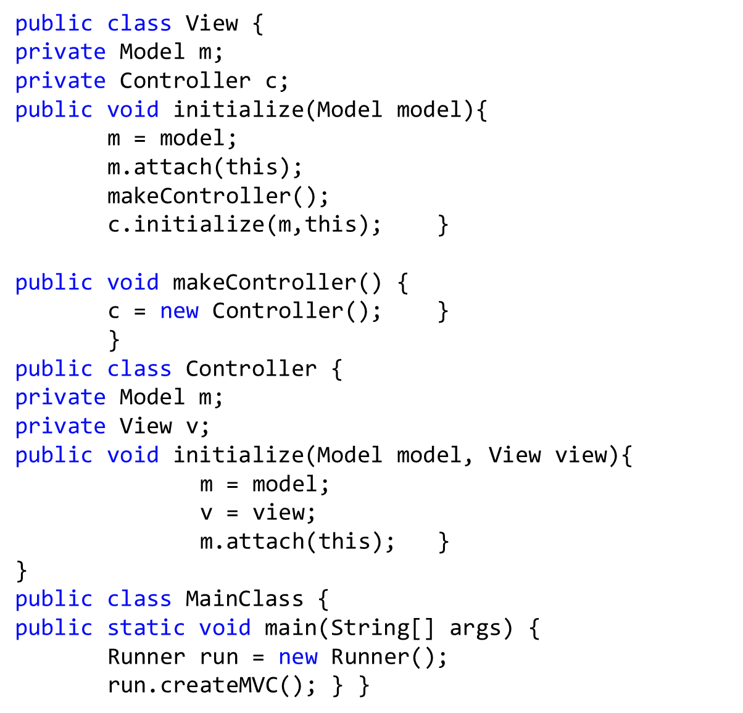

Slide 4
Object-Oriented Design
“After identifying your requirements and creating a domain model, then create software classes, and define the messaging between the objects to fulfill the requirements.”
Often make Sequence diagram and Class Diagram in parallel using the domain model and SSD

Slide 5
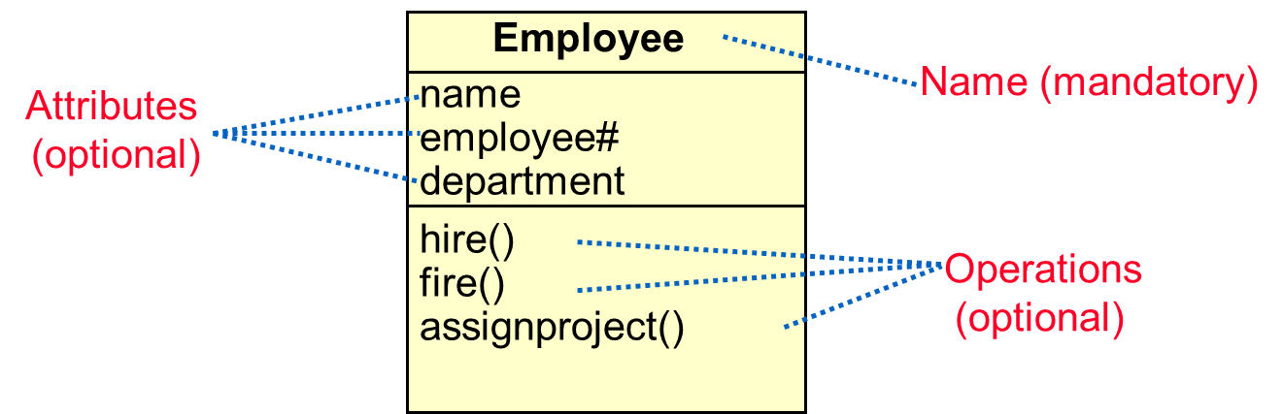
Class Diagram
A class consists of
properties (attributes),
behavior (operations),
relationships to other objects,
Examples
Employee: has a name, employee# and department; an employee is hired, and fired; an employee works in one or more projects

Slide 6
Class Diagram Notation
Attribute
type
Name of the class
Attribute
name
Student
+ name: string = “Anon”
+ registeredIn: Course [*]
+ register (c: Course)
+ isRegistered (c: Course) : Boolean
Visibility:
+, -, #
Default value
Multiplicity
Operation
name
Return value
Parameters
Notes:
‹#›

Slide 7
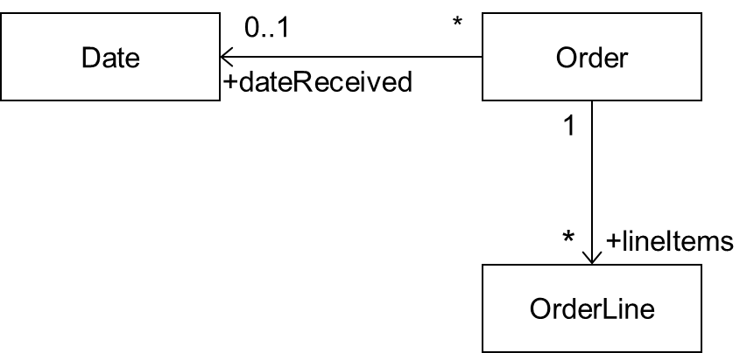
Navigability
Order
+ dateReceived: Date [0..1]
+ isPrepaid: Boolean
+ lineItems: OrderLine [*]

Slide 8
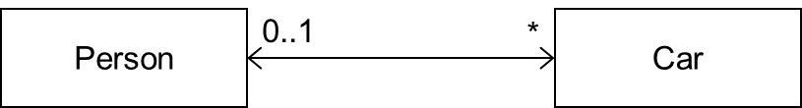
Bidirectional Association
How implement it?
Person
+ carsOwned: Car [*]
Car
+ Owner: Person [0..1]

Slide 9
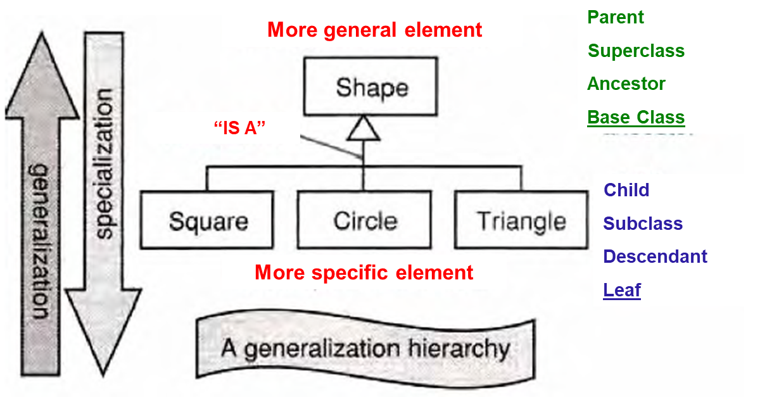
Generalization/Specialization
Generalization hierarchies may be created by generalizing from specific things or by specializing from general things.

Slide 10
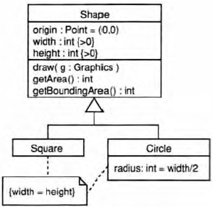
Inheritance
Class inheritance is implicit in a generalization relationship between classes.
Subclasses inherit attributes, associations, & operations from the superclass
What is the inheritance mechanism in Java?

Slide 11
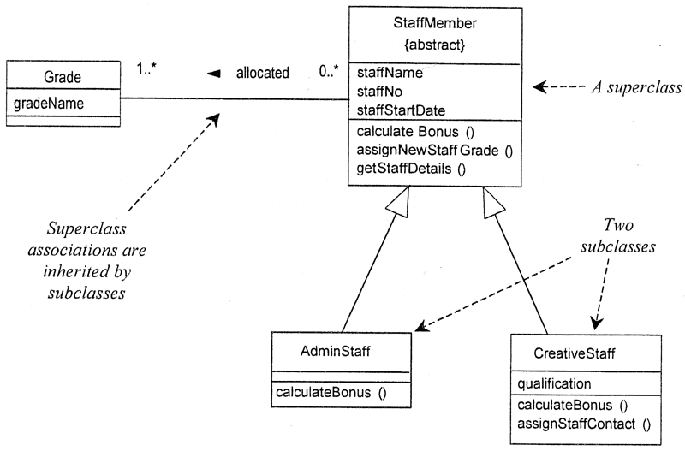
Inheritance
Java Inheritence
A subclass may override an inherited aspect
e.g. AdminStaff & CreativeStaff have different
methods for calculating bonuses
A Subclass may add new features
qualification is a new attribute in CreativeStaff
Superclasses may be declared {abstract}, meaning they have no instances
Implies that the subclasses cover all possibilities
e.g. there are no other staff than AdminStaff and CreativeStaff

Slide 12
Aggregation
This is the “Has-A” relationship
aggregation
Club
Member
*
*
:Car
:Train
0..1
:Person
0..1
0..*
driver
1
passengers
aggregation

Slide 13
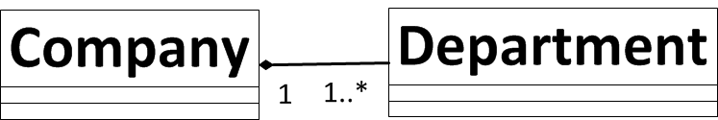
Aggregation and Composition
Composition is strong form of aggregation that implies ownership:
if the whole is removed from the model, so is the part.
the whole is responsible for the disposition of its parts
Note: Parts can be removed from the composite (where allowed) before the composite is deleted
Polygon
{ordered}
Point
centre
Circle
3..*
1

Slide 14
Aggregation and Composition
1
:Engine
composition
:Locomotive
1..*
1
0..1
:Car
:Train
0..1
:Person
0..1
0..*
driver
1
passengers
aggregation

Slide 15
Object-Oriented Design
“After identifying your requirements and creating a domain model, then add methods to the software classes, and define the messaging between the objects to fulfill the requirements.”
But how?
How should concepts be implemented by classes?
What method belongs where?
How should the objects interact?
This is a critical, important, and non-trivial task

Slide 16
Design Patterns - GRASP
A design pattern is a general repeatable solution to a commonly occurring problem in software design
Design patterns can speed up the development process by providing tested, proven development paradigms
Responsibility Driven Development
General Responsibility Assignment Software Patterns
Controller
Information Expert
Creator
Low Coupling
High Cohesion
Pure Fabrication

Slide 17
Controller
A simple layered architecture has a user interface layer (UI) and a business logic layer.
Actors, such as the human user, generate UI events (such as clicking a button).
The UI software objects (such as a JFrame window and a JButton) must process the event.
When objects in the UI layer pick up an event, they must delegate the request to an object in the domain layer.
Problem: What first object in the business logic layer should receive the message from the UI layer?
OR in other words
Who should be responsible for handling system events ?

Slide 18
Controller
The Controller is also an important idiom in modern web development frameworks, in forming a pillar of the Model-View-Controller architectural pattern. Controllers are used in AngularJS, Ruby on Rails, Sails and more.

Slide 19
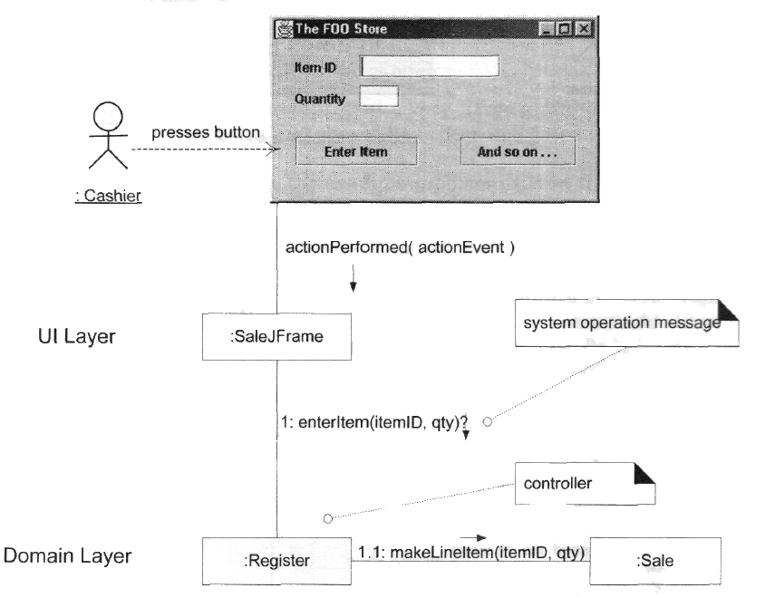
Problem: What first object in the business logic layer should receive the message from the UI layer?
Solution:
Façade Controller to hide the complexity
Works as a wrapper
Should not contain business logic

Slide 20
Controller
Which class will receive the first system call?
Deals with how to delegate the request from the UI layer objects to domain layer objects.
When a request comes from UI layer object, Controller pattern helps us in determining what is that first object that receive the message from the UI layer objects.
This object is called controller object which receives request from UI layer object and then controls/coordinates with other object of the domain layer to fulfill the request.
It delegates the work to other class and coordinates the overall activity.
Notes:
Select a class which represent the whole system

Slide 21
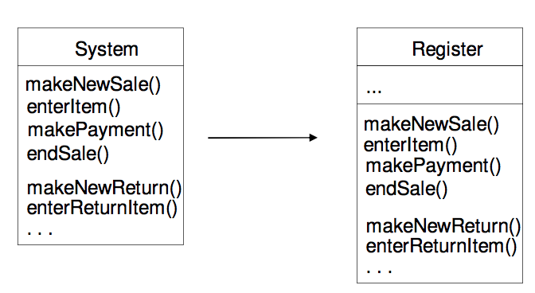
Façade Controller
All system operations are assigned to one controller.

Slide 22
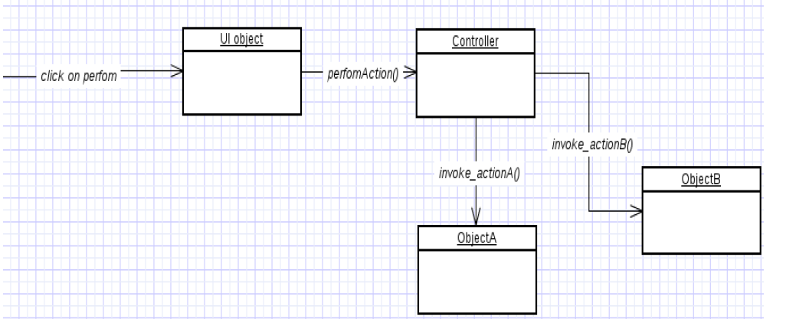
Controller
We can make an object as Controller, if
– Object represents the overall system (facade controller)
– Object represent a use case, handling a sequence of operations (session controller).
Benefits
– can reuse this controller class.
– Can use to maintain the state of the use case.
– Can control the sequence of the activities
Notes:
Controller act as a barrier between actual business logic and outside world.

Slide 23
Bloated Controller
Controller class is called bloated, if
– The class is overloaded with too many responsibilities.
– Solution: Add more controllers
The responsibility of controller class is to delegate things to others.
It will not perform any kind of business logic/ calculations.

Slide 24
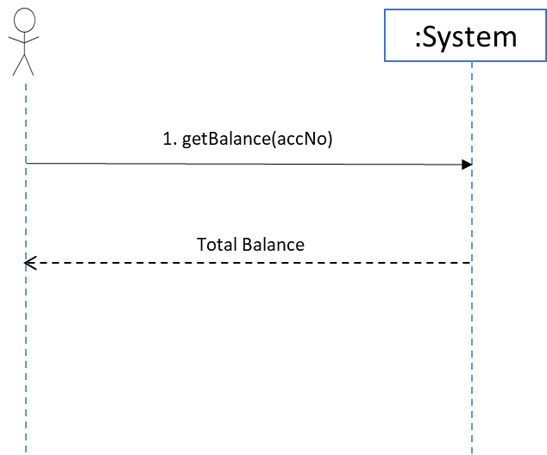
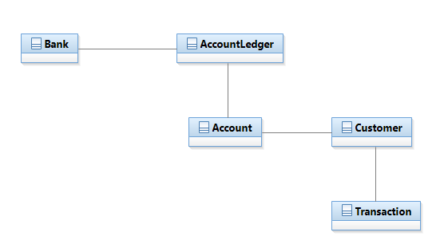
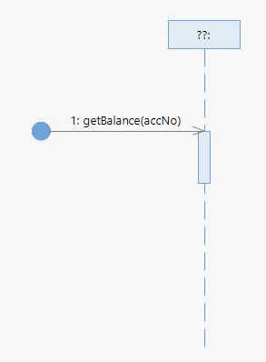
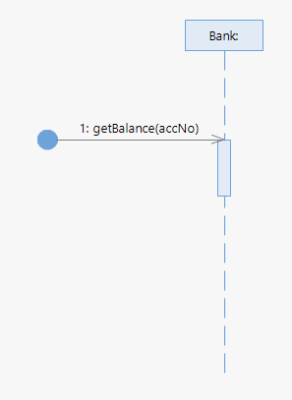
Example
System Sequence Diagram
Domain Model
Sequence Diagram
Notes:
Open the system in the form of SDs.

Slide 25
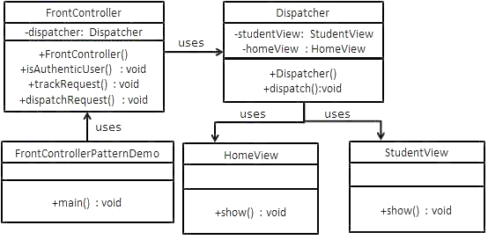
Controller Demo

Slide 26
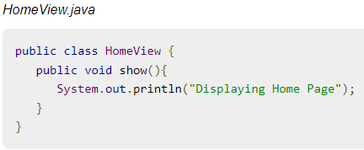
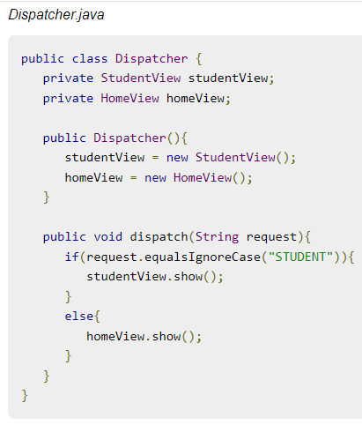
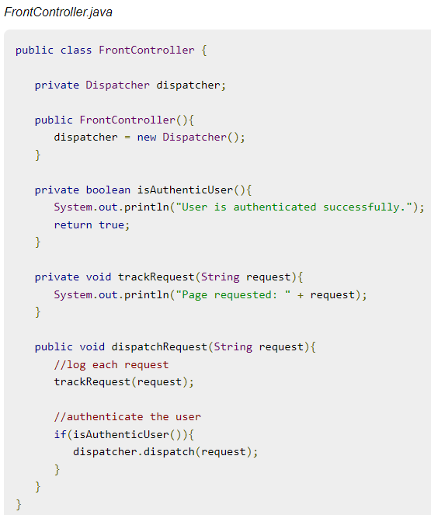
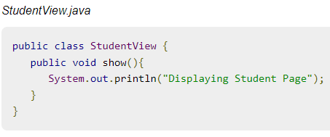
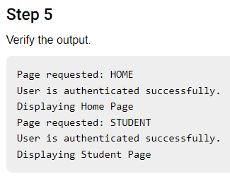
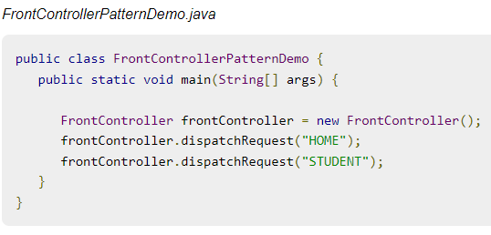

Slide 27
Information Expert
Problem : What is general principle of assigning responsibilities to Objects?
Solution : Assign Responsibility to class that has the information to fulfil the responsibility
Decision of which class to call? The class that has relevant data
Can be current class or some other class

Slide 28
Benefits
Information encapsulation is maintained since objects use their own information to fulfill tasks.
This usually supports low coupling, which leads to more robust and maintainable systems.
Behavior is distributed across the classes that have the required information, thus encouraging more cohesive "lightweight" class definitions that are easier to understand and maintain.

Slide 29
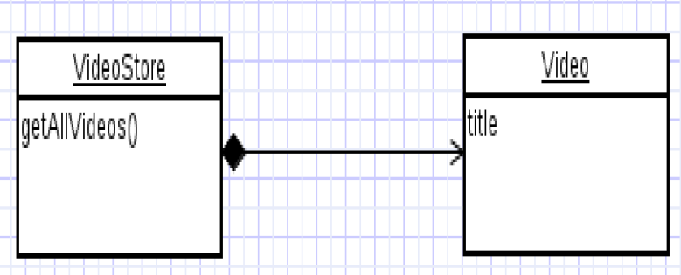
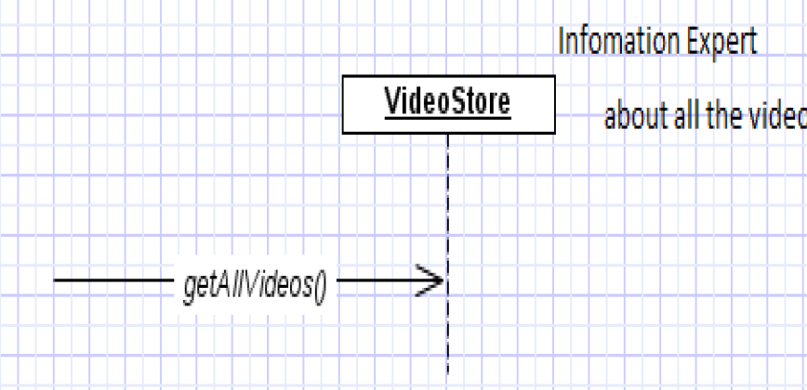
Example
Assume we need to get all the videos of a VideoStore.
Since VideoStore knows about all the videos, we can assign this responsibility of giving all the videos can be assigned to VideoStore class.
VideoStore is the information expert.

Slide 30
Creator
Problem: Who should be responsible for creating new instances of a class?
“Container” object creates “contained” objects.
Decide who can be creator based on the objects association and their interaction.
Solution: B creates If,
B aggregates A
B contains A
B records A
B closely uses A
B initializes A

Slide 31
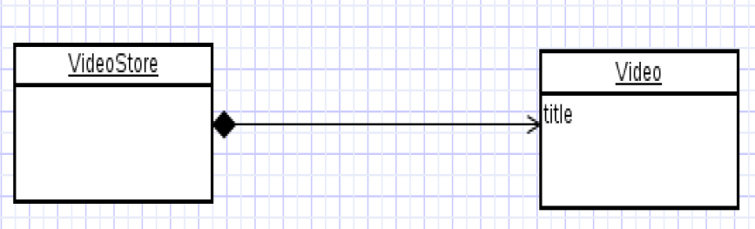
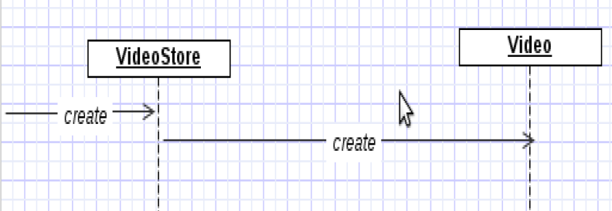
Sequence Diagram – illustrates Creator Pattern

Slide 32
Low Coupling
Problem: How to support Low dependency, low change impact, increase re-use ?

Slide 33
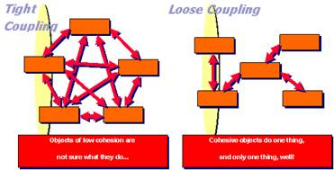
Coupling
How dependent one element (e.g. class) is on other elements (e.g. classes)
Coupling is a measure of how strongly one element is connected to, has knowledge of, or relies on other elements.
High coupling is problematic
High coupling

Slide 34
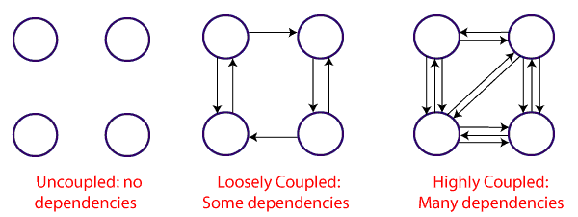
Problems with High Coupling
High coupling would mean that your class knows the way too much about the inner workings of other classes.
classes that know too much about other classes make changes hard to coordinate and make code brittle and difficult to reuse.
If class A knows too much about class B, changes in class B may break the functionality in class A.

Slide 35
Low Coupling
Problem: How to achieve low dependency, low change impact, increase re-use ?
Solution : Assign responsibilities so that coupling remains low.

Slide 36
Low Coupling
Low coupling is an evaluative pattern that dictates how to assign responsibilities for the following benefits:
lower dependency between the classes
change in one class having a lower impact on other classes
higher reuse potential.
High coupling
Low coupling

Slide 37
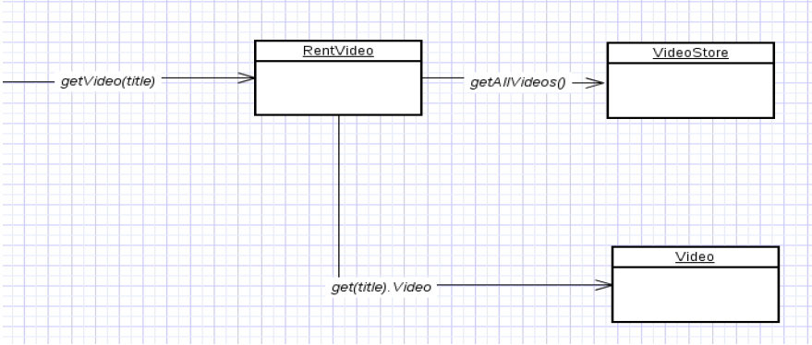
Example (High Coupling)

Slide 38
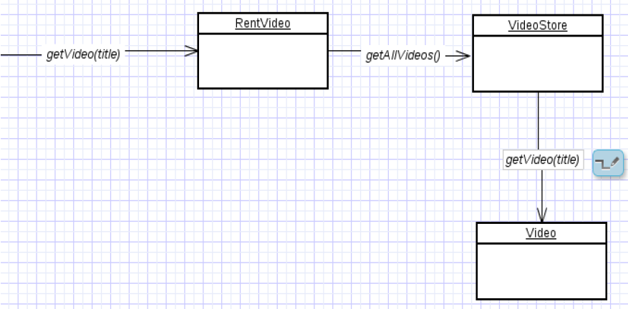
Example (Low Coupling)

Slide 39
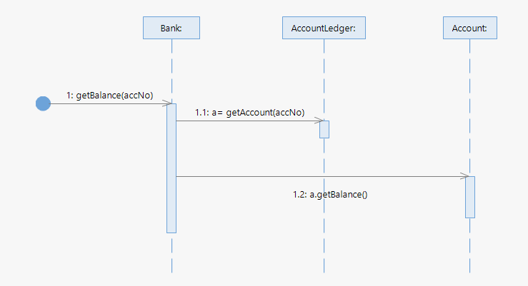
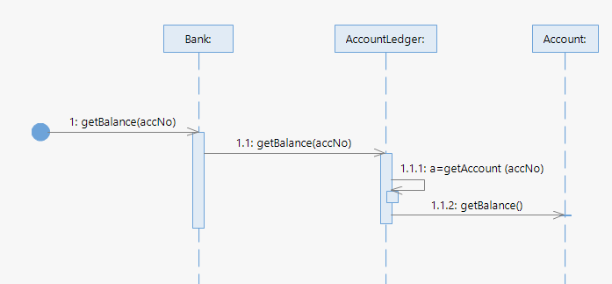
Example
Domain Model
System Sequence Diagram
Sequence Diagram
Design Alternative
Poor Design
Notes:
Minimizing the unnecessary interaction
AccountLedger and Account class is information expert

Slide 40
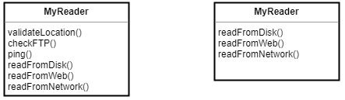
High Cohesion
Cohesion refers to how the functions of a class belong together. Related code should be close to each other to make it highly cohesive.
Problem: How to keep complexity manageable ?
Solution : Assign responsibilities so that cohesion remains high.
Note low cohesion and high coupling often go together.

Slide 41
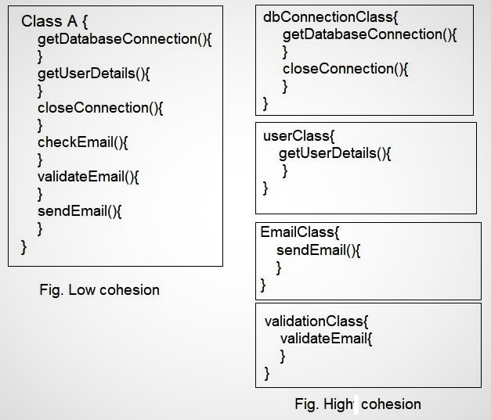
High Cohesion
How are the operations of any element functionally related?
Related responsibilities in to one manageable unit
Prefer high cohesion
Clearly defines the purpose of the element
Benefits
Easily understandable and maintainable.
Code reuse
Low coupling

Slide 42
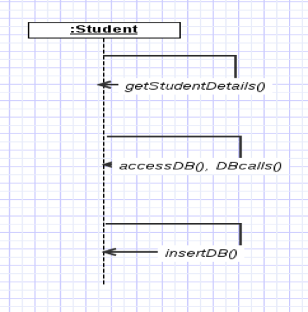
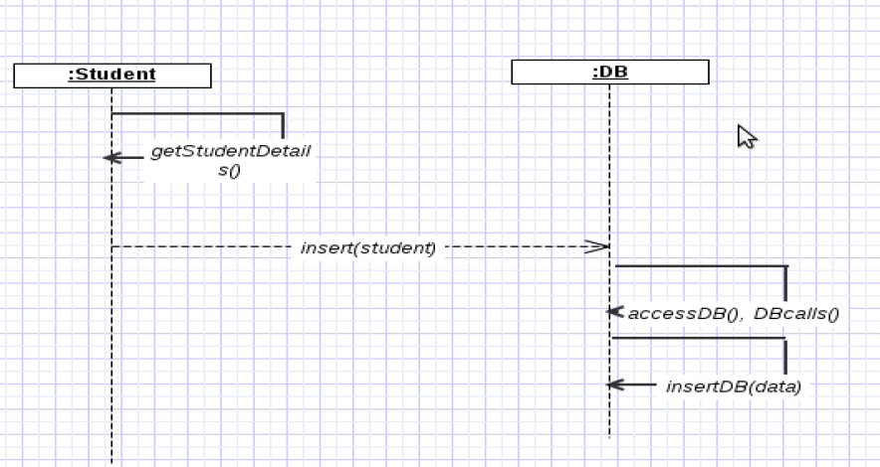
Example of Low Cohesion
Example of High Cohesion

Slide 43
Pure Fabrication
If domain model provides no reasonable concept to assign responsibility without violating cohesion/coupling -> create a new abstraction (e.g., PersistantStorage).
Assign a highly cohesive set of responsibilities to an artificial or convenience class that does not represent a problem domain concept—something made up, to support high cohesion, low coupling, and reuse

Slide 44
GRASP Pattern
Initial Domain Model
Sequence Diagram
Software Class
Sale
date
time
1
Contains
*
:Sale
Product
Specification
date
time
SalesLineItem
t := getTotal()
*
1
: Sale
quantity
Described by
description
price
itemID
getTotal()

Slide 45
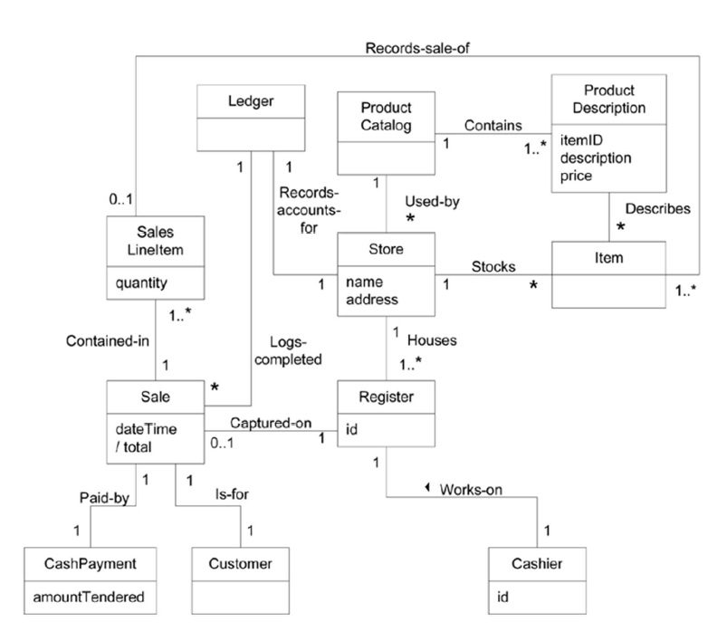
Domain Model

Slide 46
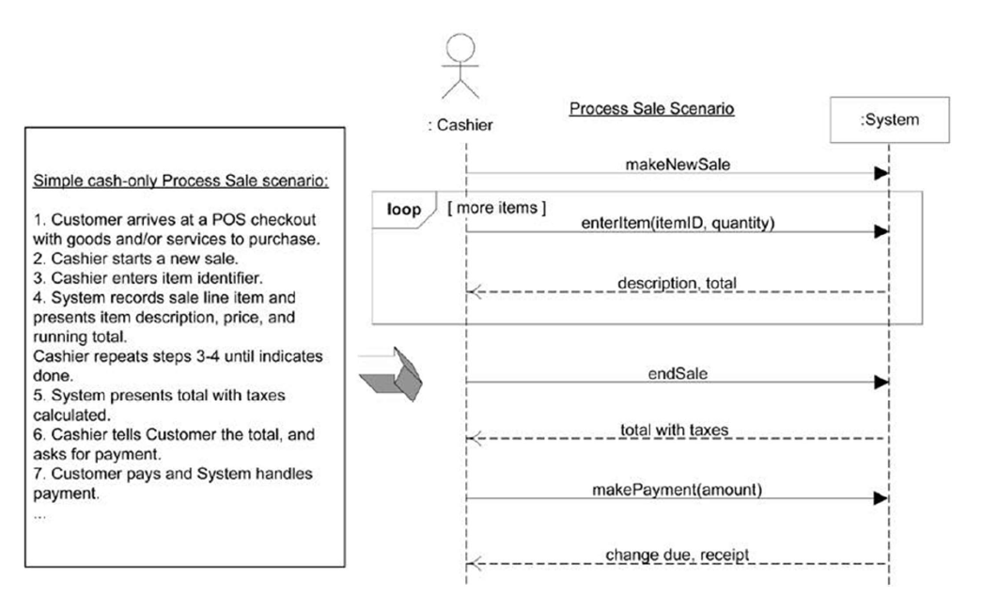
System Sequence Diagram

Slide 47
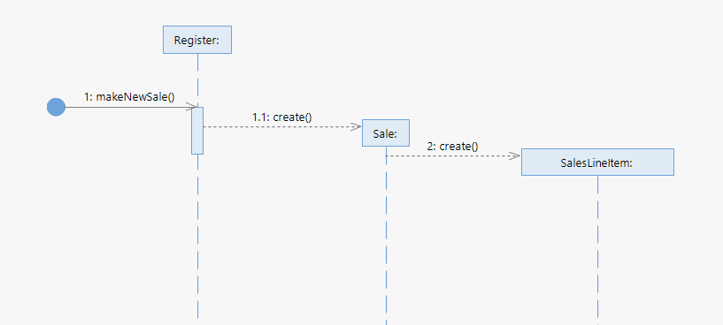
makeNewSale()
Controller ?
Information Expert ??
Creator ??

Slide 48
Explanation
Register may be thought of as recording a Sale
Register is a reasonable candidate for creating a Sale.
By having the Register create the Sale, the Register can easily be associated with it over time,
During future operations within the session, the Register will have a reference to the current Sale instance.
When the Sale is created
it must create an empty collection (container) to record all future SalesLineItem instances that will be added.
This collection will be contained within and maintained by the Sale instance,
Therefore:
the Register creates the Sale
the Sale creates an empty collection, represented by a multiobject in the interaction diagram.

Slide 49
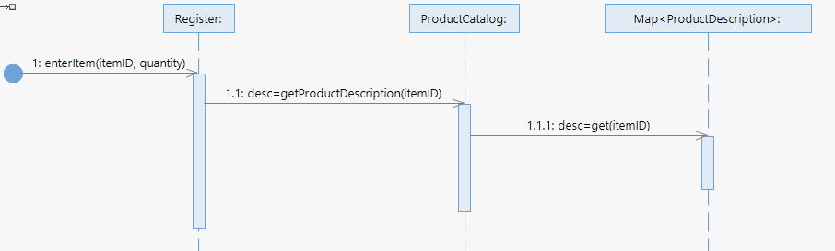
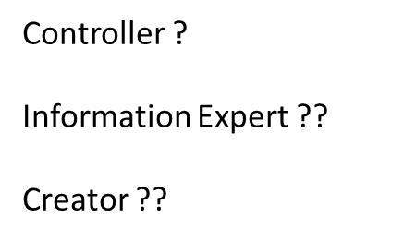
enterNewItem(itemID, quantity)
First step: access ProductDescription based on the itemID
ProductCatalog is information expert of ProductDescriptions

Slide 50
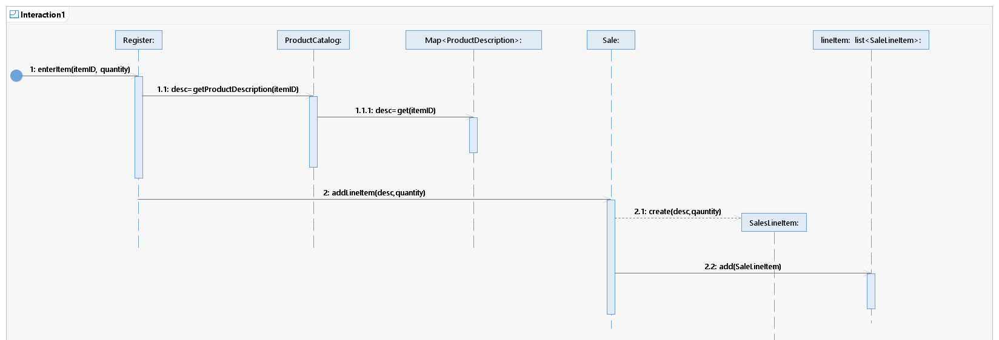

Slide 51
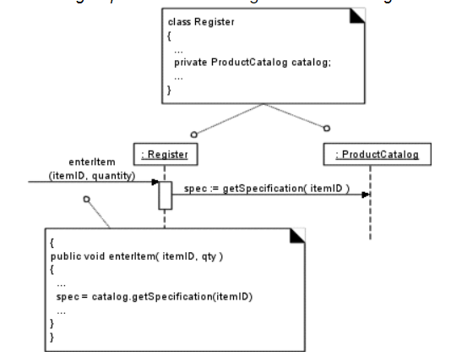
Code level view

Slide 52
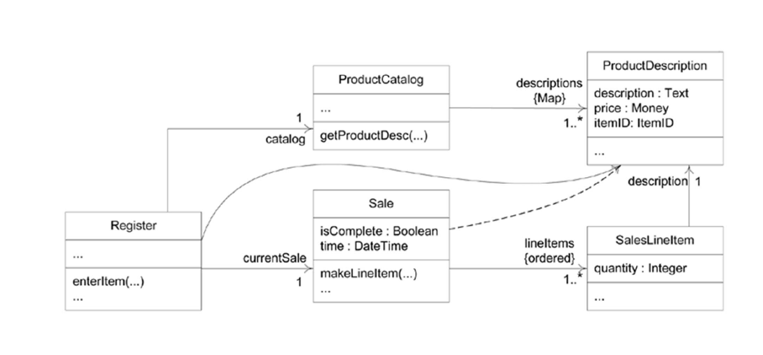
Class Diagram, So far

Slide 53
endSale – Design Decisions
Sale is to be completed
Total with tax calculated is presented

Slide 54
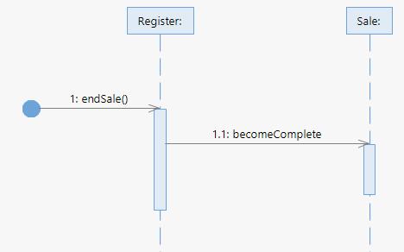
endSale()

Slide 55
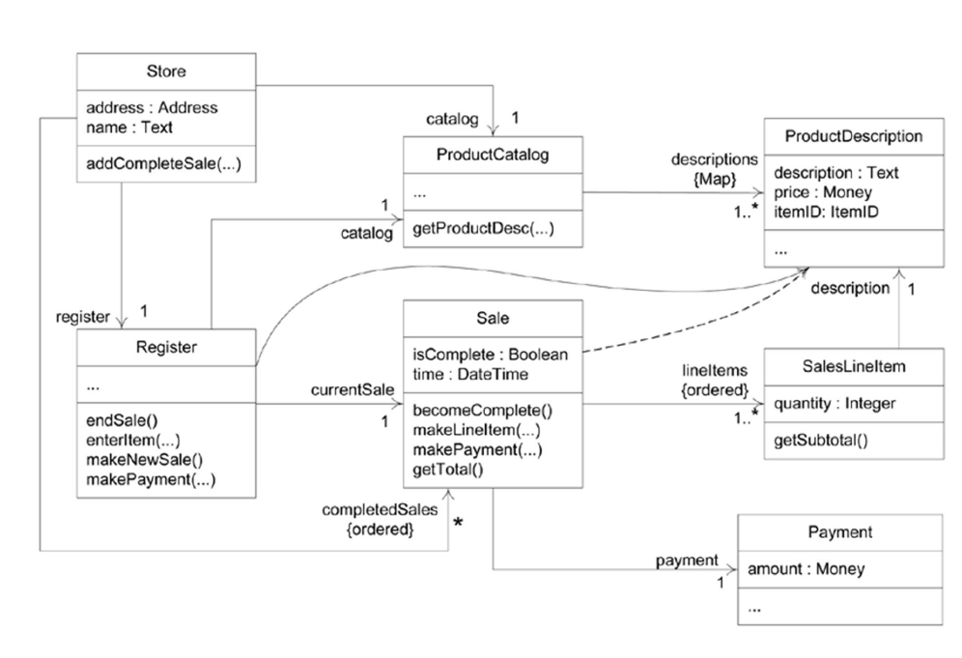

Slide 56
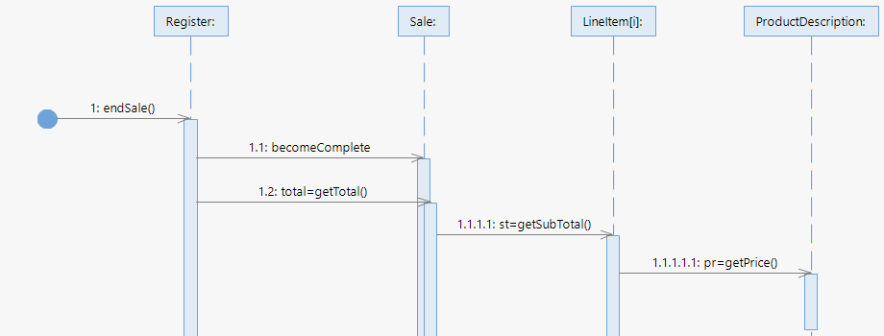
getTotal()

Slide 57
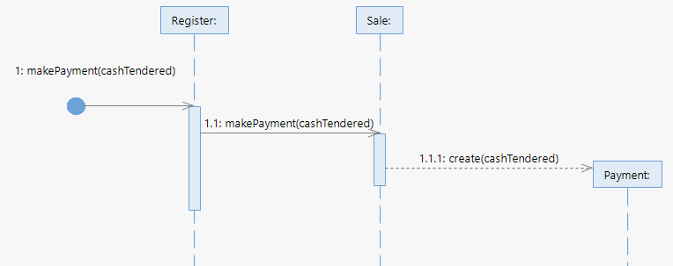
makePayment(cashTendered)

Slide 58


